Slide 1
Object Detection
Qingrun Zhang

Slide 2
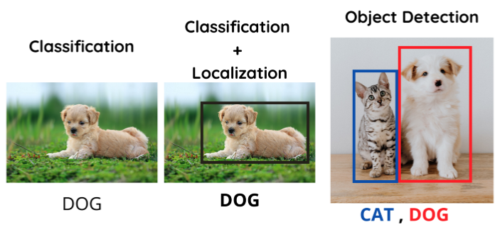
Image Classification vs. Object Detection
Image Classification helps us to classify what is contained in an image.
Image Localization will specify the location of single object in an image
Object Detection specifies the location of multiple objects in the image.

Slide 3
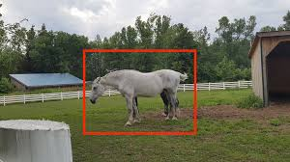
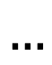
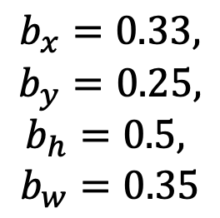
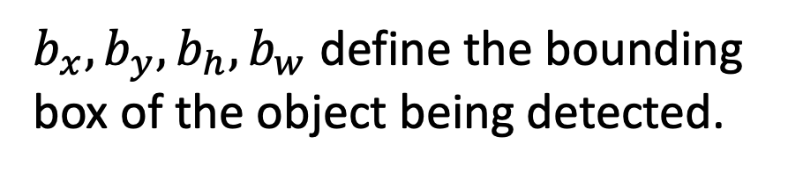
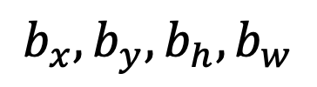
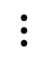
Classification and localization
Output layer
[0,0]
[b_{x}, b_{y}]
Softmax
1, 2, 3, 4
$$…$$
b_{h}
$$⋮$$
b_{w}
$$b_{x},b_{y},b_{h},b_{w}$$
[1,1]
$b_{x},b_{y},b_{h},b_{w}$ define the bounding box of the object being detected.
1. Horse
2. Cow
3. Human
4. background
$$b_{x}=0.33,$$
$$b_{y}=0.25,$$
$$b_{h}=0.5,$$
$$b_{w}=0.35$$

Slide 4
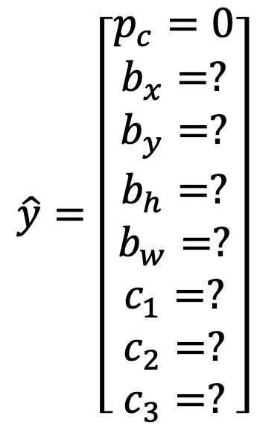
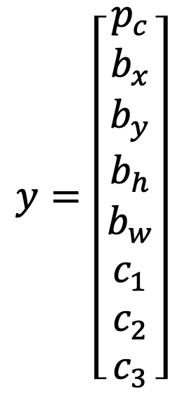
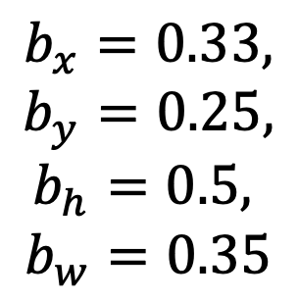
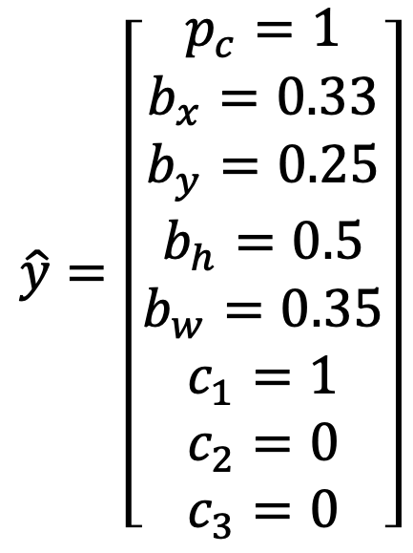
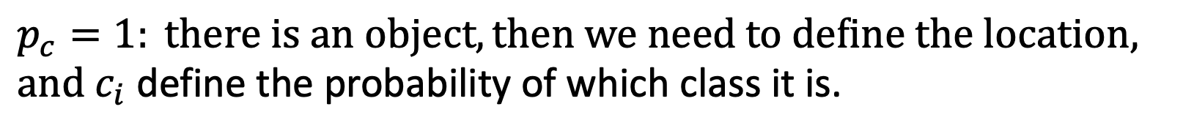
Defining the target label y
$p_{c}=1: there is an object, then we need to define the location, and{ c}_{i}$ define the probability of which class it is.
$$y=\left[\begin{matrix}p_{c} \\ b_{x} \\ \begin{aligned}b_{y} \\ b_{h} \\ b_{w} \\ c_{1} \\ c_{2} \\ c_{3}\end{aligned}\end{matrix}\right]$$
[b_{x}, b_{y}]
$$\hat{y}=\left[\begin{matrix}p_{c}=1 \\ b_{x}=0.33 \\ \begin{aligned}b_{y}=0.25 \\ b_{h}=0.5 \\ b_{w}=0.35 \\ c_{1}=1 \\ c_{2}=0 \\ c_{3}=0\end{aligned}\end{matrix}\right]$$
$$\hat{y}=\left[\begin{matrix}p_{c}=0 \\ b_{x}=? \\ \begin{aligned}b_{y}=? \\ b_{h}=? \\ b_{w}=? \\ c_{1}=? \\ c_{2}=? \\ c_{3}=?\end{aligned}\end{matrix}\right]$$
b_{h}
b_{w}
1. Horse
2. Cow
3. Human
4. background
$$b_{x}=0.33,$$
$$b_{y}=0.25,$$
$$b_{h}=0.5,$$
$$b_{w}=0.35$$
Notes:
if there's no object in the image, pc would be equal to 0, and the rest of the elements will be don't cares,

Slide 5
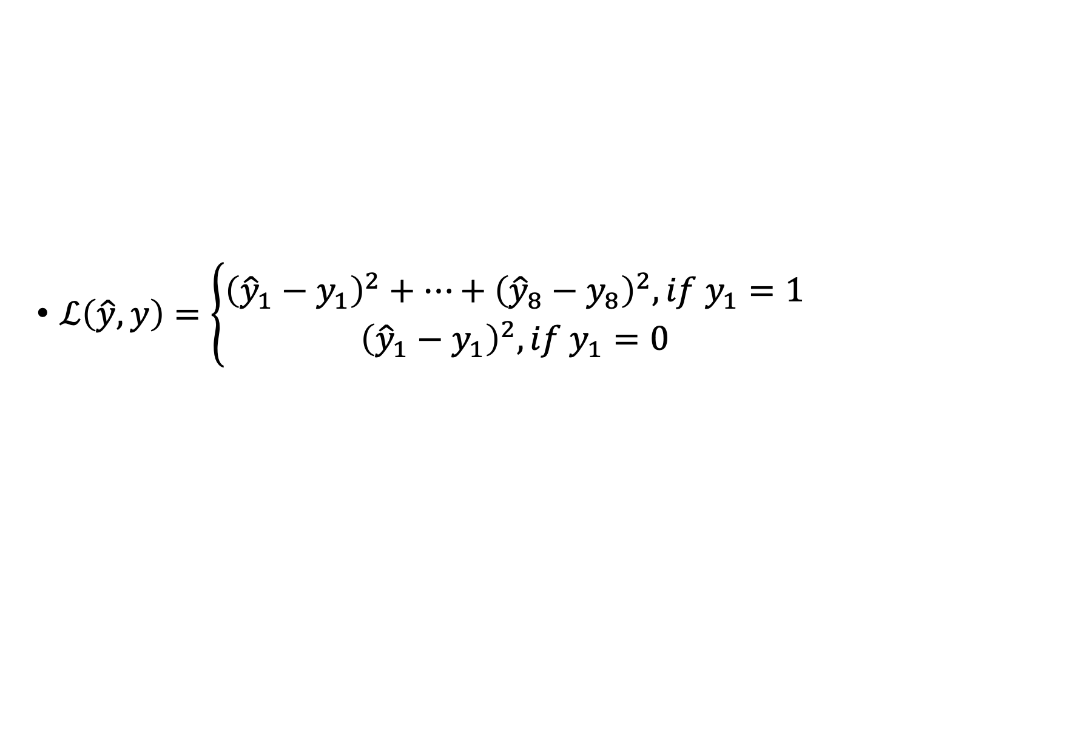
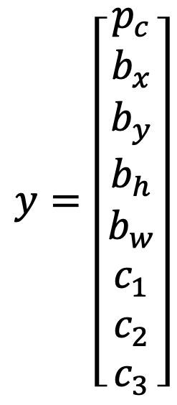
Defining loss function
$ℒ\left(\hat{y},y\right)=\left\{\begin{aligned}{\left({\hat{y}}_{1}−y_{1}\right)}^{2}+…+{\left({\hat{y}}_{8}−y_{8}\right)}^{2}, if y_{1}=1 \\ {\left({\hat{y}}_{1}−y_{1}\right)}^{2}, if y_{1}=0\end{aligned}\right.$
$$y=\left[\begin{matrix}p_{c} \\ b_{x} \\ \begin{aligned}b_{y} \\ b_{h} \\ b_{w} \\ c_{1} \\ c_{2} \\ c_{3}\end{aligned}\end{matrix}\right]$$
In practice you could probably use a log like feature loss for the c1, c2, c3 to the softmax output. One of those elements usually you can use squared error or something like squared error for the bounding box coordinates and if a pc you could use something like the logistics regression loss.
Notes:
next let's describe the loss function. The ground true label was y and the neural network outputs some yhat. What should be the loss be? if you're using squared error
then the loss can be (y1 hat- y1) squared + (y2 hat- y2) squared + ...+( y8 hat- y8) squared. Notice that y here has eight components. So that goes from sum of the squares of the difference of the elements.
And that's the loss if y1=1. So that's the case where there is an object. So y1= pc. pc = 1, that if there is an object in the image then the loss can be the sum of squares of all the different elements.
The other case is if y1=0, so that's if this pc = 0. the loss can be just (y1 hat-y1) squared, because in that second case, all of the rest of the components are don't care us.

Slide 6
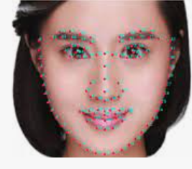
Landmark Detection
Example: face recognition, we would like to detect the edge of eyes, nose, mouth etc, so our neural network output are a list of landmark coordinates.
We need pre-labeled dataset to train the NN model
All labels have to be consistent across different images
Notes:
In more general cases, you can have a neural network just output X and Y coordinates of important points of image, called landmarks, that you want the neural networks to recognize. For example, building a face recognition application we want the algorithm to tell us where is the edge of eyes, nose, mouth etc. The neural network can output the estimated position of landmark coordinates.
For example, you can extract the mouth shape and tell if the person is smiling or frowning, The neural network can output all the key landmarks on a face. In order to train a network like this, you will need a label training set. someone will have to go through and tedious annotate all of these landmarks.
So, this idea might seem quite simple of just adding a bunch of output units to output the X,Y coordinates of different landmarks you want to recognize. To be clear, the identity of landmark one must be consistent across different images like maybe landmark one is always left corner of the left eye, landmark two is always right corner of the left eye, and so on. So, the labels have to be consistent across different images. But if you can hire labelers or label yourself a big enough data set to do this, then a neural network can output all of these landmarks which is going to used to carry out other interesting effect such as with the pose of the person, maybe try to recognize someone's emotion from a picture, and so on.

Slide 7
https://www.analyticsvidhya.com/blog/2021/12/landmark-detection-with-deep-learning/#:~:text=What%20is%20Landmark%20Detection%3F,is%20used%20by%20Google%20Maps.

Slide 8
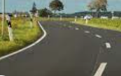
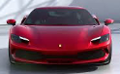
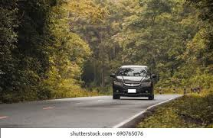
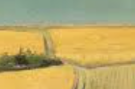
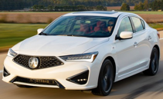
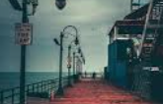
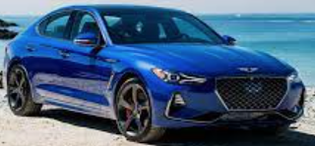
Sliding window detection
Notes:
Let’s learn how to use a ConvNet to perform object detection using something called the Sliding Windows Detection Algorithm. For example, a car detection algorithm. first we need a labeled training set, so x and y with closely cropped examples of cars, which means you end up with the car centered in pretty much the entire image. Some has car, some doesn't
you can then train a ConvNet that inputs an image, output y, zero or one, is there a car or not. Once you've trained up this ConvNet you can then use it in Sliding Windows Detection.
First, pick a window size, then you would input that into the ConvNet, and have a ConvNet make a prediction. it'll tell whether the red square contain a car or not. You then slide the window a little bit, and feed that to the ConvNet and so on. And you keep going until you've slid the window across every position in the image. Then we take a slightly larger region resize this region into whatever input size the ConvNet is expecting, and feed that to the ConvNet and have it output zero or one. And then slide the window over again using some stride and so on.
And then you might do the third time using even larger windows and so on. The hope is that if you do this, then so long as there's a car somewhere in the image that there will be a window where, for example if you are passing in this window into the ConvNet, hopefully the ConvNet will have outputs one for that input region. So then you detect that there is a car there. So this algorithm is called Sliding Windows Detection
There's a huge disadvantage of Sliding Windows Detection, which is the computational cost. Because you're cropping out so many different square regions in the image and running each of them independently through a ConvNet. if you use a very coarse stride, a very big stride, then that will reduce the number of windows you need to pass through the ConvNet, but that courser granularity may hurt performance. Whereas if you use a very fine granularity or a very small stride, then the huge number of all these little regions you're passing through the ConvNet means that means there is a very high computational cost. sliding windows this way is infeasibly slow. Fortunately, this problem of computational cost has a pretty good solution. In particular, the Sliding Windows Object Detector can be implemented convolutionally or much more efficiently.

Slide 9
Convolutional implementation of sliding windows
y
Max Pool
FC
5 x 5 x 3
FC
16
2 x 2
$$⋮$$
$$⋮$$
14 x 14 x 3
10 x 10 x 16
5 x 5 x 16
400
400
Softmax (4)
5 x 5 x 3
Max Pool
FC
5 x 5 x 16
FC
16
2 x 2
400
14 x 14 x 3
10 x 10 x 16
5 x 5 x 16
1 x 1 x 400
1 x 1 x 400
1 x 1 x 4
Source: Andrew NG
Notes:
To understand the convolutional implementation of sliding windows let's first see how you can turn fully connected layers into convolutional layers.
So let's say that the inputs 14 by 14 by 3 images. it then uses 16 of 5 by 5 filters to map it from 14 by 14 by 3 to 10 by 10 by 16. And then use a 2 by 2 max pooling to reduce it to 5 by 5 by 16. Then has a fully connected layer to connect to 400 units. Then now they're fully connected layer and then finally outputs a Y using a softmax unit. Y as four numbers, corresponding to the probabilities of the four classes for example, pedestrian, car, motorcycle, and background.
Now, what I'd like to do is show how these layers can be turned into convolutional layers. So, the convnet will draw same as before for the first few layers. one way of implementing this next layer, this fully connected layer is to implement this as a 5 by 5 filter and let's use 400 5 by 5 filters. So if you take a 5 by 5 by 16 image and convolve it with a 5 by 5 filter, remember, a 5 by 5 filter is implemented as 5 by 5 by 16 because our convention is that the filter looks across all 16 channels. And if you have 400 of these 5 by 5 by 16 filters, then the output dimension is going to be 1 by 1 by 400. So rather than viewing these 400 as just a set of nodes, we're going to view this as a 1 by 1 by 400 volume. Mathematically, this is the same as a fully connected layer because each of these 400 nodes has a filter of dimension 5 by 5 by 16. So each of those 400 values is some arbitrary linear function of these 5 by 5 by 16 activations from the previous layer. Next, to implement the next convolutional layer, we're going to implement a 1 by 1 convolution. If you have 400 1 by 1 filters then, with 400 filters the next layer will again be 1 by 1 by 400. So that gives you this next fully connected layer. And then finally, we're going to have another 1 by 1 filter, followed by a softmax activation. So as to give a 1 by 1 by 4 volume to take the place of these four numbers that the network was operating. So this shows how you can take these fully connected layers and implement them using convolutional layers

Slide 10
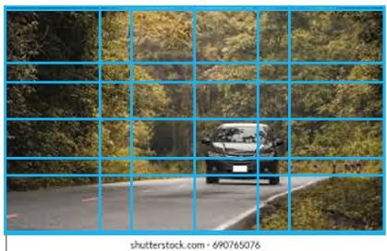
Convolutional implementation of sliding windows
16 x16 x 3
12 x12 x 16
6 x 6 x 16
2 x 2 x 400
2 x 2 x 400
2 x 2 x 4
Max Pool
FC
FC
5 x 5 x 3
16
2 x 2
Pros: Instead of doing it sequentially, one can implement the entire image, make all the predictions by one forward pass through
Cons: the position of the bounding boxes is not accurate
Source: Andrew NG
Sermanet et al, 2014 OverFeat: Integrated recognition, localization and detection using convolutional networks
Notes:
let's see how you can have a convolutional implementation of sliding windows object detection. The presentation on this slide is based on the OverFeat paper. let's say that your convnet inputs 14 by 14 by 3 images and your tested image is 16 by 16 by 3. In the original sliding windows algorithm, you might want to input the red region into a convnet and run that once to generate a classification 0 and 1 and then sliding down a bit, for example, uses a stride of two pixels and then you might slide that to the right by two pixels to input this green rectangle into the convnet and we run the whole convnet and get another label, 01. Then you input this orange region into the convnet and run it one more time to get another label. And then do it the fourth and final time with this lower right purple square. To run sliding windows on this 16 by 16 by 3 image, You run this convnet four times in order to get four labels. But it turns out a lot of this computation done by these four convnets is highly duplicative. So what the convolutional implementation of sliding windows does is it allows these four passes in the convnet to share a lot of computation. Specifically, here's what you can do. You can take the convnet and just run it same parameters, the same 5 by 5 filters, also 16 5 by 5 filters and run it. Now, you can have a 12 by 12 by 16 output volume. Then do the max pool, same as before. Now you have a 6 by 6 by 16, runs through your same 400 5 by 5 filters to get now your 2 by 2 by 400 volume. So now instead of a 1 by 1 by 400 volume, we have instead a 2 by 2 by 400 volume. Run it through a 1 by 1 filter gives you another 2 by 2 by 400 instead of 1 by 1 like 400. Do that one more time and now you're left with a 2 by 2 by 4 output volume instead of 1 by 1 by 4. It turns out that this red 1 by 1 by 4 subset gives you the result of running in the upper left hand corner 14 by 14 image. This upper right 1 by 1 by 4 volume gives you the upper right result. ... And if you step through all the steps of the calculation,
what this convolution implementation does is, instead of forcing you to run four propagation on four subsets of the input image independently, it combines all four into one form of computation and shares a lot of the computation in the regions of image that are common. So all four of the 14 by 14 patches we saw here.

Slide 11
Bounding box prediction
With sliding windows, in the case, none of the boxes really match up perfectly with the position of the car
Our goal is to get more accurate bounding boxes
Solution: YOLO (You Only Look Once) algorithm
Redmon et al., 2015 You Only Look Once: Unified, Real-Time Object Detection

Slide 12
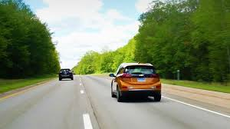
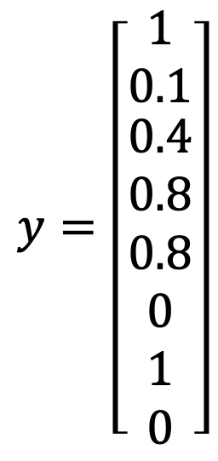
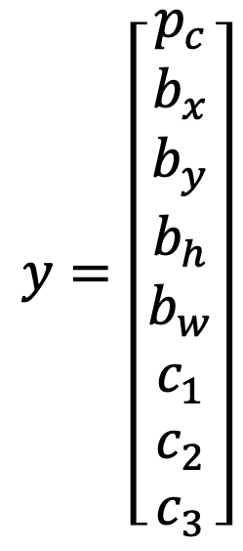
Bounding box prediction
$$y=\left[\begin{matrix}p_{c} \\ b_{x} \\ \begin{aligned}b_{y} \\ b_{h} \\ b_{w} \\ c_{1} \\ c_{2} \\ c_{3}\end{aligned}\end{matrix}\right]$$
$$y=\left[\begin{matrix}1 \\ 0.1 \\ \begin{aligned}0.4 \\ 0.8 \\ 0.8 \\ 0 \\ 1 \\ 0\end{aligned}\end{matrix}\right]$$
YOLO algorithm takes the midpoint of reach objects and then assigns the object to the grid cell containing the midpoint.
The target output will be 3 x 4 x 8, because 3 x 4 cells
Using finer grid to reduce the chance of multiple objects in one cell
(0,0)
(1,1)
Place down a grid on the input image.
Apply image classification and localization algorithm on each of the grids
Define labels Y for each of the grid cells.
3 x 4 x 8
Notes:
Even though some grid cell has some parts of a car, we'll pretend the that grid cell has no interesting object, if the center of the object is not in the cell.
to train your neural network, the input is 100 by 100 by 3, that's the input image. And then you have a usual convnet with conv, layers of max pool layers, and so on. So that in the end, you have this, should choose the conv layers and the max pool layers, and so on, so that this eventually maps to a 3 by 4 by 8 output volume.
So the advantage of this algorithm is that the neural network outputs precise bounding boxes, as long as you don't have more than one object in each grid cell, this algorithm should work okay.
this is a lot like the image classification and localization algorithm that outputs the bounding box coordinates explicitly. And this algorithm allows your network to output much more precise coordinates. And second, this is a convolutional implementation and you're not implementing this algorithm 12 times on the 3 by 4 grid. Instead, this is one single convolutional implementation So, this is a pretty efficient algorithm. And in fact, the YOLO algorithm, which is constant popularity is because this is a convolutional implementation, it actually runs very fast. So this works even for real time object detection.

Slide 13
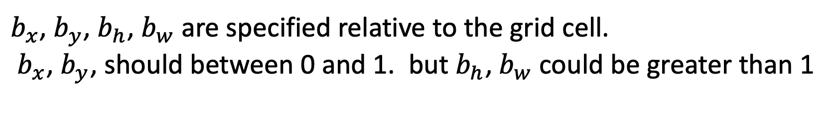
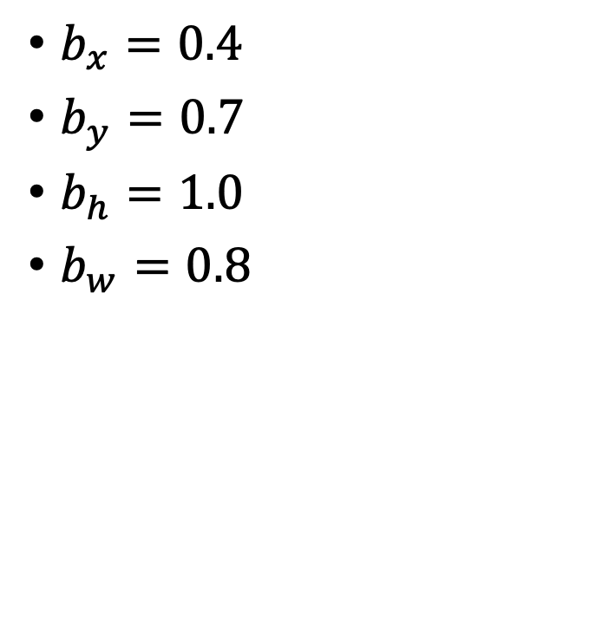
How to encode bounding box?
$$y=\left[\begin{matrix}p_{c} \\ b_{x} \\ \begin{aligned}b_{y} \\ b_{h} \\ b_{w} \\ c_{1} \\ c_{2} \\ c_{3}\end{aligned}\end{matrix}\right]$$
$b_{x}=0.4$
$b_{y}=0.7$
$b_{h}=1.0$
$b_{w}=0.8$
(0,0)
(1,1)
$b_{x}$, $b_{y}$, $b_{h}$, $b_{w}$are specified relative to the grid cell.
$b_{x}$, $b_{y}$, should between 0 and 1. but $b_{h}$, $b_{w}$could be greater than 1
Redmon et al., 2015 You Only Look Once: Unified, Real-Time Object Detection
Notes:
Let's take the example of the car on the right. So, in this grid cell there is an object and so the target label y will be one, that was PC is equal to one. And then bx, by, BH, BW, and then 0 1 0. So, how do you specify the bounding box? In the YOLO algorithm, relative to this square, when I take the convention that the upper left point here is (0,0) and this lower right point is (1,1). So to specify the position of that midpoint, bx by, should be coordinate of the yellow dot. Maybe bx=0.4, by=0.7. And then the height of the bounding box is specified as a fraction of the overall width of grid box. So, the width of this red box is maybe 100% of the grid width. And so BH is 0.8 and the height of the overall height of the grid cell. this bx, by, BH, BW as specified relative to the grid cell. And so bx and by, this has to be between 0 and 1, Because pretty much by definition that red dot is within the bounds of that grid cell is assigned to. If it wasn't between 0 and 1 it was outside the square, then we'll have been assigned to a different grid cell. But bh and bw could be greater than one. So, there are multiple ways of specifying the bounding boxes, but this would be one convention that's quite reasonable. There are some other more advanced parameterizations that work things a little bit better, but the one you saw here should work okay. So, that's it for the YOLO or the You Only Look Once algorithm.

Slide 14
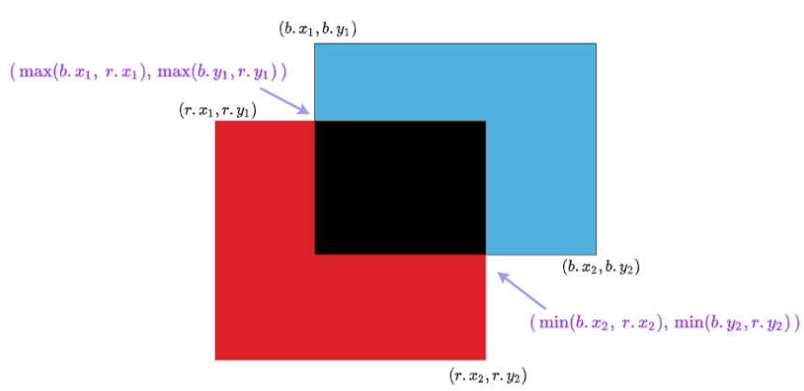
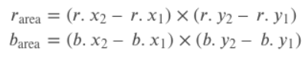
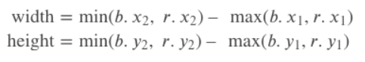
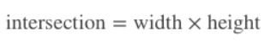
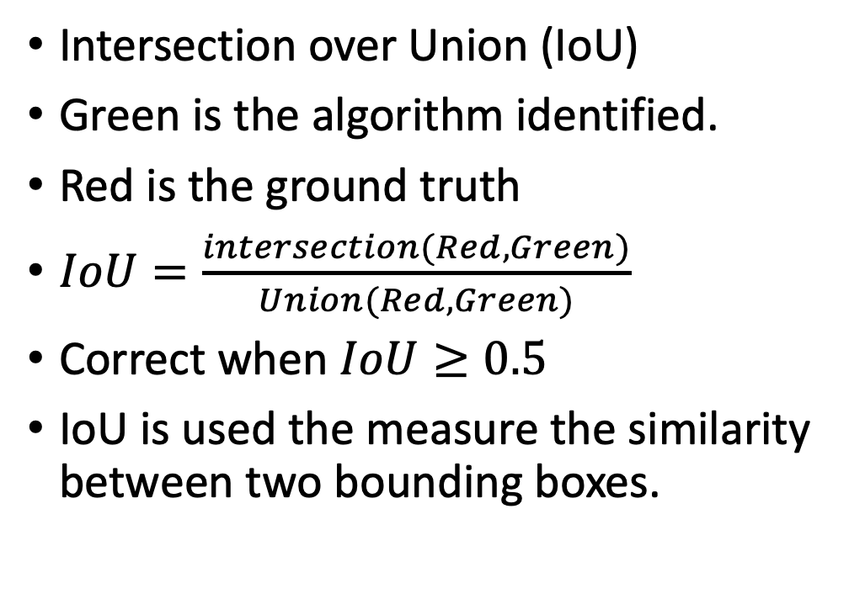
Evaluating object localization accuracy
Intersection over Union (IoU)
Green is the algorithm identified.
Red is the ground truth
$IoU=\frac{intersection(Red, Green)}{Union(Red, Green)}$
Correct when $IoU≥0.5$
IoU is used the measure the similarity between two bounding boxes.
Notes:
if the red box is the ground-truth bounding box, but your algorithm outputs the green bounding box, is this a good outcome or a bad one?

Slide 15
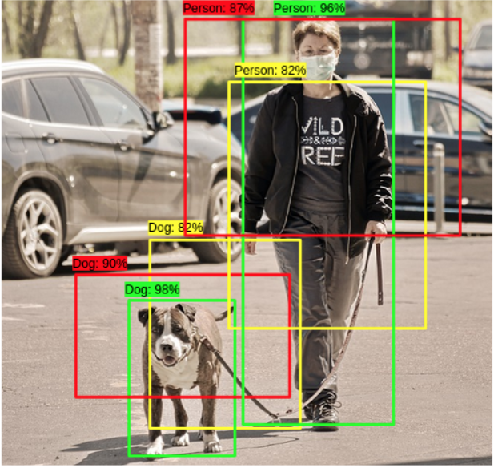
Non Max Suppression (NMS)
Define a value for Confidence_Threshold, and IOU_Threshold.
Sort the bounding boxes in a descending order of confidence.
Remove boxes that have a confidence < Confidence_Threshold
Loop over all the remaining boxes, starting first with the box that has highest confidence. Box_S
Calculate the IOU of the Box_S, with every remaining box
If the IOU of the 2 boxes > IOU_Threshold, remove the box with a lower confidence from our list of boxes.
Repeat this operation until we have gone through all the boxes in the list.
Notes:
One of the problems of Object Detection is that your algorithm may find multiple detections of the same objects. Rather than detecting an object just once, it might detect it multiple times. Non-max suppression is a way for you to make sure that your algorithm detects each object only once.
For a given image, you might place a grid over this, while technically the midpoint of each object should be assigned just one grid cell. so technically only one of the grid cells should predict that there is a object. In practice, you're running an object classification and localization algorithm for everyone of these split cells. So it's quite possible that several split cell might think that the center of an object is in it. So, when you run your algorithm, you might end up with multiple detections of each object. non-max suppression cleans up these detections. So they end up with just one detection per object,

Slide 16
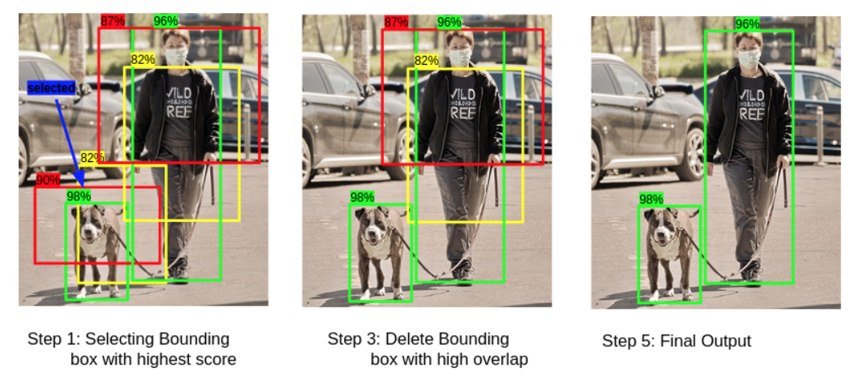
Non Max Suppression (NMS)

Slide 17
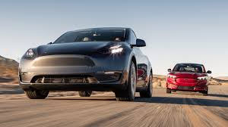
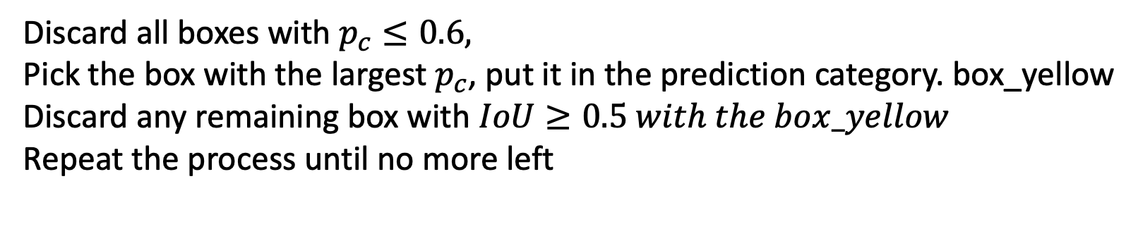
Non Max Suppression (NMS)
0.98, x1, x2, x3, x4
0.43, x1, x2, x3, x4
0.72, x1, x2, x3, x4
0.68, x1, x2, x3, x4
0.96, x1, x2, x3, x4
0.89, x1, x2, x3, x4
Discard all boxes with $p_{c}≤0.6,$
Pick the box with the largest $p_{c}$, put it in the prediction category. box_yellow
Discard any remaining box with $IoU≥0.5 with the box_yellow$
Repeat the process until no more left

Slide 18
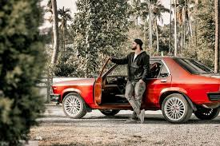
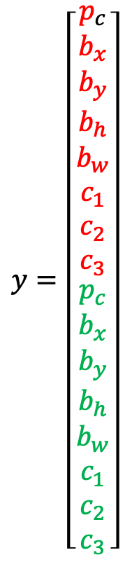
Anchor boxes
Predefine several anchor boxes for each grid cell.
Each object in the training image is assigned to grid cell that contains the midpoint and anchor box for the grid cell with highest IoU
Not working well:
When the # of objects in one grid cell is more than # of anchor boxes
Or several objects in the same grid cell, but have same anchor box shape
$$y=\left[\begin{matrix}p_{c} \\ b_{x} \\ \begin{aligned}b_{y} \\ b_{h} \\ b_{w} \\ c_{1} \\ c_{2} \\ c_{3} \\ \begin{matrix}p_{c} \\ b_{x} \\ \begin{aligned}b_{y} \\ b_{h} \\ b_{w} \\ c_{1} \\ c_{2} \\ c_{3}\end{aligned}\end{matrix}\end{aligned}\end{matrix}\right]$$
Anchor box 1
Anchor box 2
Redmon et al. 2015, You Only Look Once: Unified real-time object detection
Notes:
anchor boxes are a way to deal with multiple objects appear in the same grid cell, having the same midpoint, it does happen, but it doesn't happen that often. Maybe even better motivation or even better results that anchor boxes gives you is it allows your learning algorithm to specialize better. In particular, if your data set has some tall, skinny objects like pedestrians, and some wide objects like cars, then this allows your learning algorithm to specialize so that some of the outputs can specialize in detecting wide, fat objects like cars, and some of the output units can specialize in detecting tall, skinny objects like pedestrians. So finally, how do you choose the anchor boxes? And people used to just choose them by hand or choose maybe five or 10 anchor box shapes that spans a variety of shapes.
Anchor boxes are a set of predefined bounding boxes of a certain height and width. These boxes are defined to capture the scale and aspect ratio of specific object classes you want to detect and are typically chosen based on object sizes in your training datasets

Slide 19
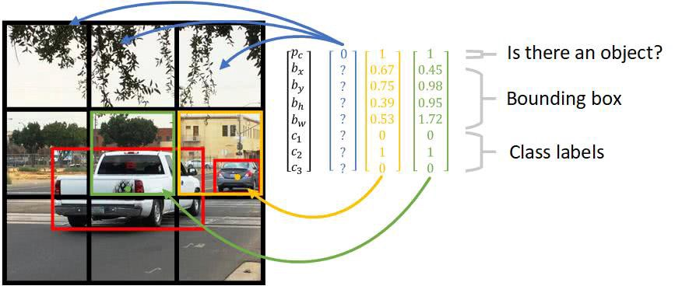
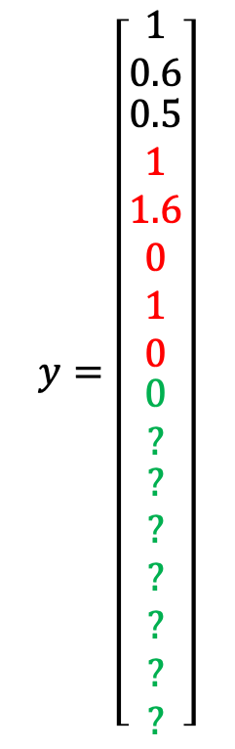
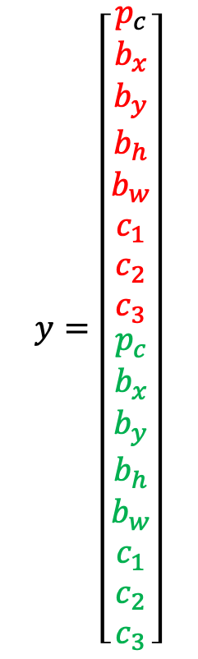
YOLO algorithm
Pedestrian
Car
Motorcycle
$$y=\left[\begin{matrix}p_{c} \\ b_{x} \\ \begin{aligned}b_{y} \\ b_{h} \\ b_{w} \\ c_{1} \\ c_{2} \\ c_{3} \\ \begin{matrix}p_{c} \\ b_{x} \\ \begin{aligned}b_{y} \\ b_{h} \\ b_{w} \\ c_{1} \\ c_{2} \\ c_{3}\end{aligned}\end{matrix}\end{aligned}\end{matrix}\right]$$
$$y=\left[\begin{matrix}1 \\ 0.6 \\ \begin{aligned}0.5 \\ 1 \\ 1.6 \\ 0 \\ 1 \\ 0 \\ \begin{matrix}0 \\ ? \\ \begin{aligned}? \\ ? \\ ? \\ ? \\ ? \\ ?\end{aligned}\end{matrix}\end{aligned}\end{matrix}\right]$$
The image is divided into s x s grid cells
If the center of an object is in one of the cell, that cell is responsible for detecting the object.
Each of the cells is responsible for predicting ‘B’ boxes each contain an object and confidence score for the object present in the box
YOLO reasons at the level of the overall picture
If you use 2 anchor boxes: y is 3 x 3 x 16
box2
Anchor box 1
Notes:
YOLO, Also Known as You Only Look Once is one of the most powerful real-time object detector algorithms. It is called that way because unlike previous object detector algorithms, like R-CNN or its upgrade Faster R-CNN it only needs the image (or video) to pass one time through its network.
Now we have the most of the components of object detection., let's put all the components together to form the YOLO object detection algorithm. First, in training set. Suppose you're algorithm try to detect three objects: pedestrians, cars, and motorcycles. And you will need to explicitly have the full background class, so just the class labels here. If you're using two anchor boxes, then the outputs y will be 3x3 (grid), x2 (anchors box), by 8 (Pc and then the bounding boxes plus the number of classes.) You can either view this as 3x3x2x8, or 3x3x16. So to construct the training set, you go through each of these nine grid cells and form the appropriate target vector y.
So assuming that your training set has a bounding box for car which is wider. So if your anchor have an anchor box one and anchor box two, then the red box has just slightly higher IoU with anchor box 1. And so, the car gets associated with this higher portion of the vector. So notice then that Pc associate anchor box one is zero. Then you have this Pc is equal to one, then you should use these to specify the position of the red bounding box, and then specify that the correct object is class two. So you go through this and for each of your nine grid positions each of your three by three grid positions, you would come up with a vector like this. Come up with a 16 dimensional vector. In practice it might be more like a 19 by 19 by 16. Or you use more anchor boxes.

Slide 20
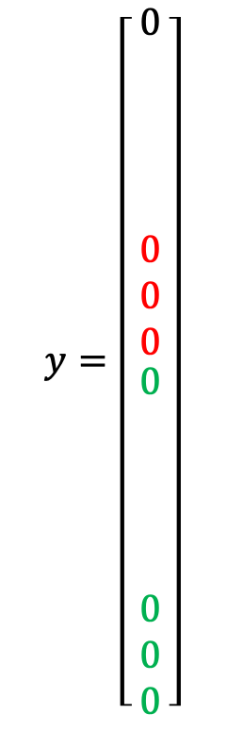
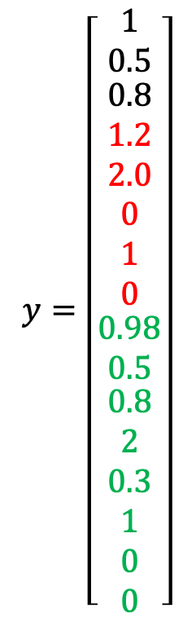
YOLO algorithm
$$y=\left[\begin{matrix}p_{c} \\ b_{x} \\ \begin{aligned}b_{y} \\ b_{h} \\ b_{w} \\ c_{1} \\ c_{2} \\ c_{3} \\ \begin{matrix}p_{c} \\ b_{x} \\ \begin{aligned}b_{y} \\ b_{h} \\ b_{w} \\ c_{1} \\ c_{2} \\ c_{3}\end{aligned}\end{matrix}\end{aligned}\end{matrix}\right]$$
$$y=\left[\begin{matrix}1 \\ 0.5 \\ \begin{aligned}0.8 \\ 1.2 \\ 2.0 \\ 0 \\ 1 \\ 0 \\ \begin{matrix}0.98 \\ 0.5 \\ \begin{aligned}0.8 \\ 2 \\ 0.3 \\ 1 \\ 0 \\ 0\end{aligned}\end{matrix}\end{aligned}\end{matrix}\right]$$
$$y=\left[\begin{matrix}0 \\ \\ \begin{aligned} \\ \\ \\ 0 \\ 0 \\ 0 \\ \begin{matrix}0 \\ \\ \begin{aligned} \\ \\ \\ 0 \\ 0 \\ 0\end{aligned}\end{matrix}\end{aligned}\end{matrix}\right]$$
Anchor box 1
Anchor box 2
Does the anchor box size predefined or H/W ratio?
Redmon et al. 2015, You Only Look Once: Unified real-time object detection
Notes:
‘Next, to make predictions. Given an image, your neural network will output 3 by 3 by 2 by 8 volume. So for the grid cell here on the upper left, if there's no object there, , your neural network will output zero here, and zero here, and it will output some other values. But these numbers will basically be ignored because the neural network is telling you that there's no object there. Hopefully, you'll also output a set of numbers that corresponds to specifying a pretty accurate bounding box for the car. So that's how the neural network will make predictions. Finally, you run this through non-max suppression.
non-max suppression, you then get rid of the low probability predictions. if you have three classes to detect, for each of the three classes, independently run non-max suppression for the objects that were predicted to come from that class. Run NMS three times to generate the final predictions. And so, the output of this is hopefully that you will have detected all the cars and all the pedestrians in this image. So that's it for the YOLO object detection algorithm. Which is really one of the most effective object detection algorithms, that also encompasses many of the best ideas across the entire computer vision literature that relate to object detection.

Slide 21
YOLO algorithm
For each grid cell, get ”B” predicted bounding boxes
Get rid of low probability predictions
For each class (pedestrian, car, motorcycle), independently run Non-Max Suppression to get the final predictions
ConvNet
S x S: # of grid
B : # of classes
5: IoU and b_{x}, b_{y}, b_{w}, b_{h}
n x n x 3
s x s x b x (5+b)
Notes:
So that's it for the YOLO object detection algorithm. Which is really one of the most effective object detection algorithms, that also encompasses many of the best ideas across the entire computer vision literature that relate to object detection.

Slide 22
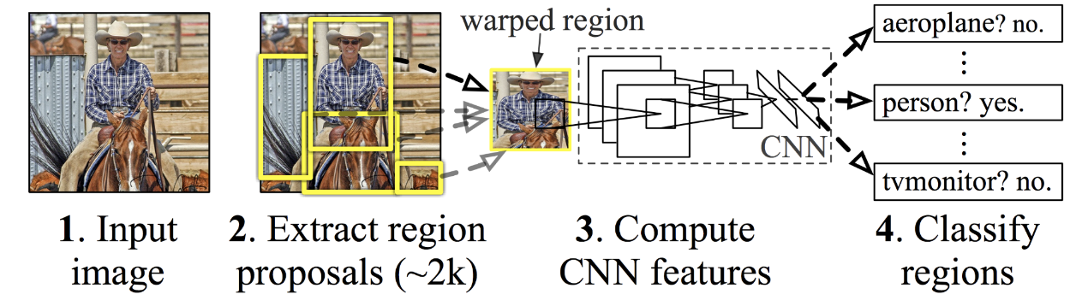
R-CNN (Region-based Convolutional Neural Networks)
The selective search algorithm uses similar to sliding window exhaustive search and works with the segmentation of the colours presented in the image
After selection of the region, the image with regions goes through a CNN where the CNN model extracts the objects from the region. Since the size of the image should be fixed according to the capacity of CNN we require some time or most of the time to reshape the image. In basic R-CNN we wrap the region into 227 x 227 x 3 size images.
Notes:
An input image given to the R-CNN model goes through a mechanism called selective search to extract information about the region of interest. Region of interest can be represented by the rectangle boundaries. Depending on the scenario there can be over 2000 regions of interest. This region of interest goes through CNN to produce output features. These output features then go through the SVM(support vector machine) classifier to classify the objects presented under a region of interest.

Slide 23
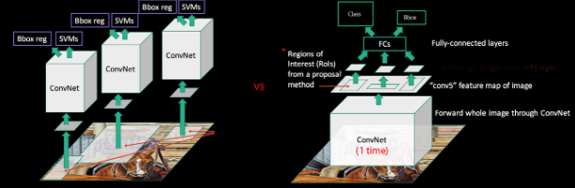
SPPNet (Spatial Pyramid Pooling Network)
SPPNet instead of working on the 2000 region to convert them into feature maps, it converts the whole image on the feature map at once.

Slide 24
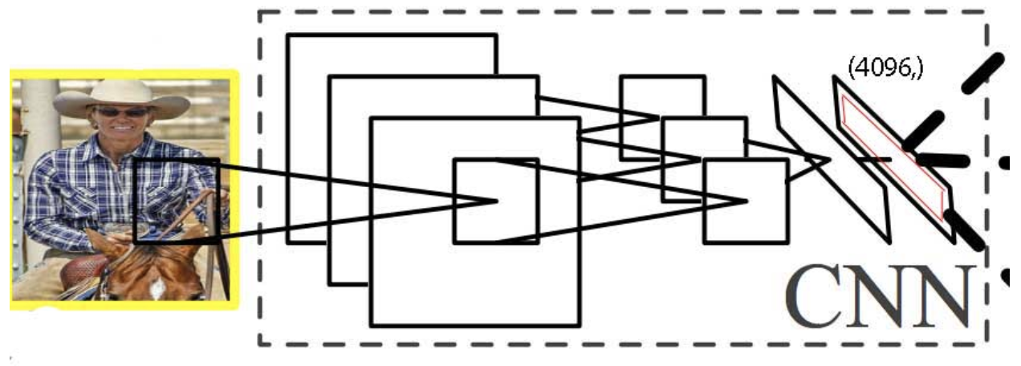
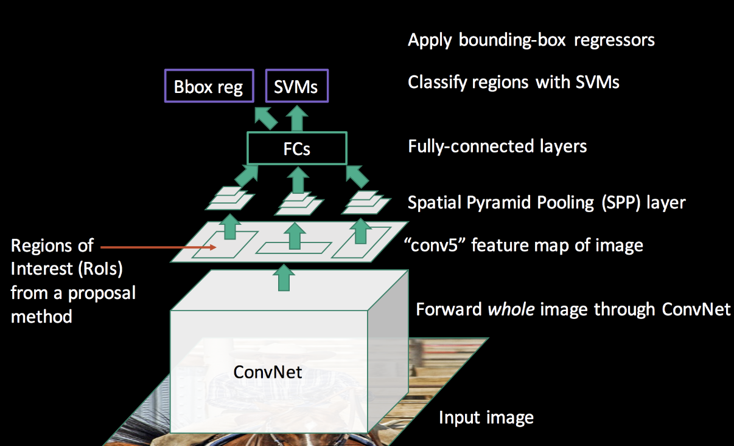
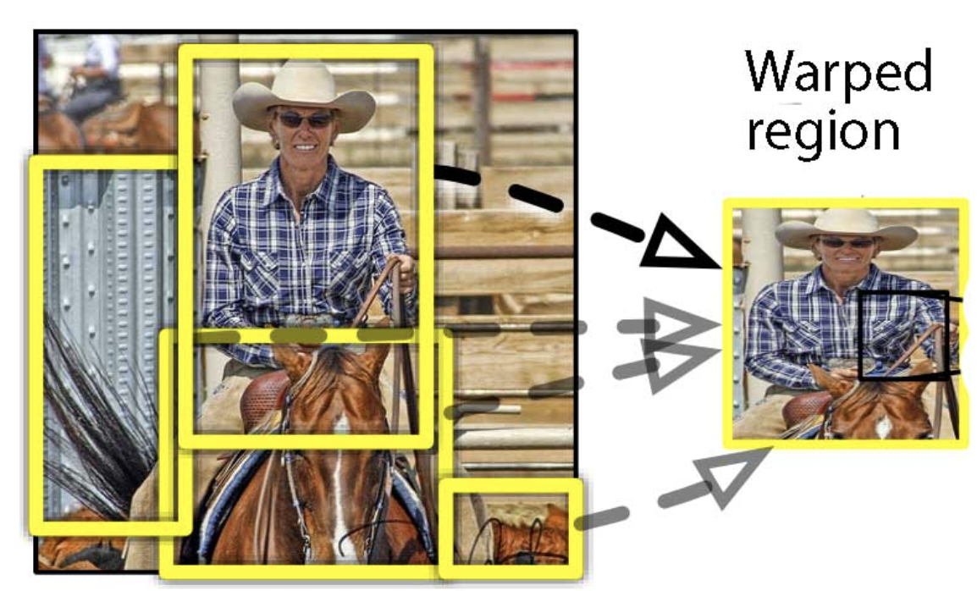
Fast R-CNN

Slide 25
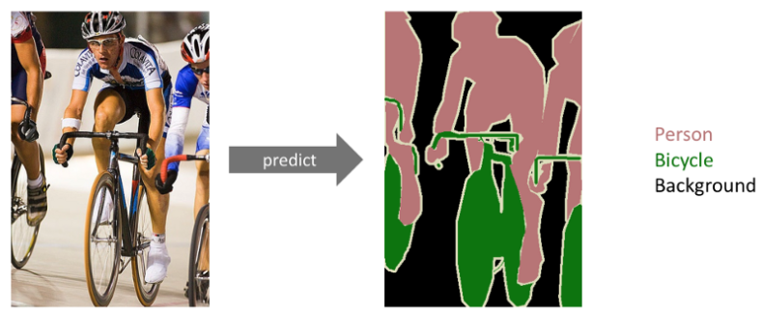
Semantic Segmentation
Object recognition/image classification: figure out what is in the picture
Object detection: find bounding box around the identified object
Semantic Segmentation: draw outline around the object. The output is a complete high-resolution image with all the pixels are classified.
Notes:
The goal of semantic image segmentation is to label each pixel of an image with a corresponding class of what is being represented. Because we’re predicting for every pixel in the image, this task is commonly referred to as dense prediction.
Note that unlike the previous tasks, the expected output in semantic segmentation are not just labels and bounding box parameters. The output itself is a high resolution image (typically of the same size as input image) in which each pixel is classified to a particular class. Thus it is a pixel level image classification.

Slide 26

Instance segmentation
Detect instances, give category, label pixels
Simultaneous detection and segmentation (SDS)
Label are class-aware and instance aware
Source: https://medium.com/towards-data-science/understanding-semantic-segmentation-with-unet-6be4f42d4b47
Notes:
Instance segmentation is one step ahead of semantic segmentation wherein along with pixel level classification, we expect the computer to classify each instance of a class separately. For example in the image above there are 5 people, technically 3 instances of the class “Person”. All the 5 are classified separately (in a different color). But semantic segmentation does not differentiate between the instances of a particular class.

Slide 27
Semantic Segmentation Applications
Autonomous vehicles: a complex robotics tasks that requires perception, planning and execution within constantly evolving environments. It need to be utmost precision, since safety is of paramount importance.
Bio Medical Image Diagnosis
Geo Sensing: To recognize the type of land cover
Precision Agriculture: semantic segmentation of crops and weeds assist them in real time to trigger weeding action
Business Problem: TGS is one of the leading Geo-science and Data companies which uses seismic images and 3D renderings to understand which areas beneath the Earth’s surface contain large amounts of oil and gas.
Source: https://medium.com/towards-data-science/understanding-semantic-segmentation-with-unet-6be4f42d4b47

Slide 28


Convolution, Max Pooling and Transposed Convolution
Convolution: the process of transforming an image by applying a kernel over each pixel and its local neighbors across the entire image
The convolution operation calculates the sum of the element-wise multiplication between the input matrix and kernel matrix.
A convolution operation forms a many-to-one relationship
Receptive field (context) is the area of the input image that the filter covers at any given point of time.

Slide 29

Max Pooling
Both convolution operation and especially the pooling operation reduce the size of the image. This is called as down sampling.
By down sampling, the model better understands “WHAT” is present in the image, but it loses the information of “WHERE” it is present.
The idea is to retain only the important features (max valued pixels) from each region and throw away the information which is not important, as result reducing the size of the feature map
The size of the filter and strides are two important hyper-parameters in the max pooling operation.
Notes:
Notice that in a typical convolutional network, the height and width of the image gradually reduces (down sampling, because of pooling) which helps the filters in the deeper layers to focus on a larger receptive field (context). However the number of channels/depth (number of filters used) gradually increase which helps to extract more complex features from the image.

Slide 30

Transposed Convolution
We need both “WHAT” and “WHERE” information in case of semantic segmentation. Need for up sampling
Transposed convolution (Deconvolution or Fractionally-strided convolution) is a technique to perform up sampling of an image with learnable parameters. We want to convert one-to-many relationship
Notes:
By down sampling, the model better understands “WHAT” is present in the image,

Slide 31
Convolution & transposed Convolution
Filter Flatten view 4 x 9
4
5
6
1
2
1
2
5
4
Input image
The transposed convolution operation forms the same connectivity as the normal convolution but in the backward direction.
We can use it to conduct up-sampling. Moreover, the weights in the transposed convolution are learnable
1 | 2 | 0 | 3 | 4 | 0 | 0 | 0 | 0
0 | 1 | 2 | 0 | 3 | 4 | 0 | 0 | 0
0 | 0 | 0 | 1 | 2 | 0 | 3 | 4 | 0
0 | 0 | 0 | 0 | 1 | 2 | 0 | 3 | 4
25
27
31
35
4 | 5 | 6
1 | 2 | 1
2 | 5 | 4
*
=
Filter
1 | 2
3 | 4
Filter transposed 9 x 4
1 | 0 | 0 | 0
2 | 1 | 0 | 0
0 | 2 | 0 | 0
3 | 0 | 1 | 0
4 | 3 | 2 | 1
0 | 4 | 0 | 2
0 | 0 | 3 | 0
0 | 0 | 4 | 3
0 | 0 | 0 | 4
2
5
2
9
18
10
9
21
12
Output
25 | 27
31 | 35
2
1
3
3
*
=
Notes:
Even though it is called the transposed convolution, it does not mean that we take some existing convolution matrix and use the transposed version. The main point is that the association between the input and the output is handled in the backward fashion compared with a standard convolution matrix (one-to-many rather than many-to-one association).

Slide 32
Transposed Convolution
Output
Filter 3 x 3
Padding p=1
Stride S=2
Output
Input
4 | 4 | 2
0 | 2 | 4
 | 2 | 1
 | 1 | 2
1 | 0 | 1
2 | 2 | 1
0 | 1 | 2
2 | 5 | 4 | 2
1 | 7 | 2 | 7
4 | 8 | 6 | 3
2 | 4 | 3 | 6
1 | 1 | 1
1 | 1 | 1
1 | 1 | 1
2 | 2 | 2
2 | 2 | 2
2 | 2 | 2
=
1 | 2
2 | 3
2 | 2 | 2
2 | 2 | 2
2 | 2 | 2
*
3 | 3 | 3
3 | 3 | 3
3 | 3 | 3
=
 | 0 | 2
 | 4 | 2
 | 2 | 4
3 | 0 | 3
6 | 6 | 3
0 | 3 | 6
On a high level, transposed convolution is exactly the opposite process of a normal convolution i.e., the input volume is a low-resolution image, and the output volume is a high-resolution image.
Notes:
In semantic segmentation it is not just important to know “WHAT” is present in the image, but it is equally important to know “WHERE” it is present. Hence, we need a way to up sample the image from low resolution to high resolution which will help us restore the “WHERE” information.
Transposed Convolution is the most preferred choice to perform up sampling, which basically learns parameters through back propagation to convert a low-resolution image to a high-resolution image.

Slide 34

U-net architecture
Skip connect
# Channels
Ronneberger et al. 2015 U-Net: Convolutional Networks for Biomedical Image Segmentation
Notes:
The architecture contains two paths. First path is the contraction path (also called as the encoder) which is used to capture the context in the image. The encoder is just a traditional stack of convolutional and max pooling layers. The second path is the symmetric expanding path (also called as the decoder) which is used to enable precise localization using transposed convolutions. Thus it is an end-to-end fully convolutional network (FCN), i.e. it only contains Convolutional layers and does not contain any Dense layer because of which it can accept image of any size.

